Slide 1
Endowment Trustees Report
CD #16.1
EBD #13.3
ET #13.3
BARC #13.3
2022 – 2023
Executive Board
BARC
Membership Information Session
Finance & Audit
Mario Gonzalez – Senior Trustee
June 23, 2023 - BARC/F&A
June 24, 2023 – Membership Information Session
June 26, 2023 – Executive Board

Slide 2
Market and Book Value as of 5-31-23*
$56,846,000
*Calendar year to date – 5 months.

Slide 3
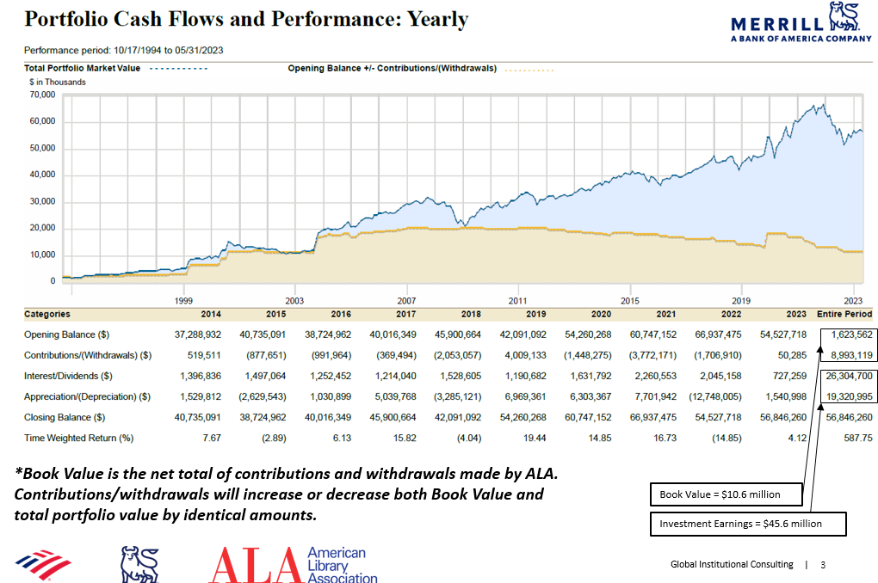
Endowment historical cash flows as of 5/31/2023
*Book value is the net total of contributions and withdrawals made by ALA. Contributions/withdrawals will increase or decrease both book value and total portfolio value by identical amounts.
* Amounts reported for contributions/Withdrawals numbers only cover assets custodied at Merrill Lynch.
Source: Merrill Lynch CRC Reporting System

Slide 4
Endowment Fund Asset Allocation
  Actual Allocation
Allocation Per Investment Policy Statement

Slide 5
Equity and Real Assets Allocation
Domestic Large/Mid Cap
 |  | % Domestic | % Portfolio
iShares ESG Aware MSCI USA ETF* | $ 11,635,007 | 50.4% | 20.5%
Nuveen ESG Large Cap Growth ETF* | $ 4,740,078 | 20.5% | 8.3%
Nuveen ESG Small Cap* | $ 1,793,364 | 7.8% | 3.2%
Vanguard Value ETF | $ 3,917,090 | 17.0% | 6.9%
Ariel Fund* | $ 989,996 | 4.3% | 1.7%
Total | $ 23,075,535 | 100.0% | 40.6%
*% of ESG & Diversity | $ 19,158,445 | 83.0%
International Equity
 |  | % International | % Portfolio
iShares ESG Aware ETF* | $ 2,935,532 | 51.7% | 5.2%
GS GQG International Opportunities* | $ 2,738,866 | 48.3% | 4.8%
Total | $ 5,674,398 | 100.0% | 10.0%
*% of ESG & Diversity | $ 5,674,398 | 100.0%
Real Assets
 |  | % Real Assets | % Portfolio
Vanguard US REIT ETF | $ 1,184,400 | 51.6% | 2.1%
iShares Global Infrastructure ETF | $ 1,111,756 | 48.4% | 2.0%
Total | $ 2,296,156 | 100.0% | 4.0%

Slide 6
Fixed Income, Alternatives and Cash Allocation
Fixed Income
 |  | % Fixed Income | % Portfolio
Guggenheim Total Return | $ 4,342,272 | 25.0% | 7.6%
PIMCO Income | $ 4,319,681 | 24.8% | 7.6%
Calvert Short Duration ESG* | $ 4,346,550 | 25.0% | 7.6%
iShares ESG Total USD Bond* | $ 4,386,232 | 25.2% | 7.7%
Total Fixed Income | $17,394,735 | 100.0% | 30.6%
*% of ESG & Diversity | $ 8,732,782 | 50.2%
Alternatives and Cash
 |  | % Alternatives and Cash | % Portfolio
Blackstone 2015 Alts Trust | $ 692,970 | 8.2% | 1.2%
KKR 2016 Custom Equity Opps | $ 783,155 | 9.3% | 1.4%
Blackstone 2018 Alts Trust | $ 1,806,118 | 21.5% | 3.2%
JLL Income Property Trust | $ 1,203,901 | 14.3% | 2.1%
The Endowment Fund | $ 276,250 | 3.3% | 0.5%
Partners Group* | $ 1,100,996 | 13.1% | 1.9%
Total Alternatives | $ 5,863,390 | 69.8% | 10.3%
Cash | $ 2,542,045 | 30.2% | 4.5%
Total Alternatives and Cash | $ 8,405,435 | 100.0% | 14.8%
*% of ESG & Diversity | $ 1,100,996 | 13.1%

Slide 7

Environmental, Social and Governance (ESG) and Diversity Portfolio Holdings
 |  | % of ESG and | % of
 | Portfolio Value | Diversity Portfolio | Total Portfolio
iShares ESG Aware MSCI USA ETF | $ 11,635,007 | 33.6% | 20.5%
Calvert Short Duration ESG | $ 4,346,550 | 12.5% | 7.6%
Nuveen ESG Large Cap ETF | $ 4,740,078 | 13.7% | 8.3%
Nuveen ESG Small Cap | $ 1,793,364 | 5.2% | 3.2%
iShares ESG Total US Bond | $ 4,386,232 | 12.7% | 7.7%
iShares ESG Aware MSCI EAFE ETF | $ 2,935,532 | 8.5% | 5.2%
Partners Group | $ 1,100,996 | 3.2% | 1.9%
Total ESG | $ 30,937,759 | 89.2% | 54.4%
Ariel | $ 989,996 | 2.9% | 1.7%
GS GQG International Opportunities | $ 2,738,866 | 7.9% | 4.8%
Total Diversity | $ 3,728,862 | 10.8% | 6.6%
Total ESG and Diversity | $ 34,666,621 | 100.0% | 61.0%
Total Portfolio | $ 56,846,260

Slide 8
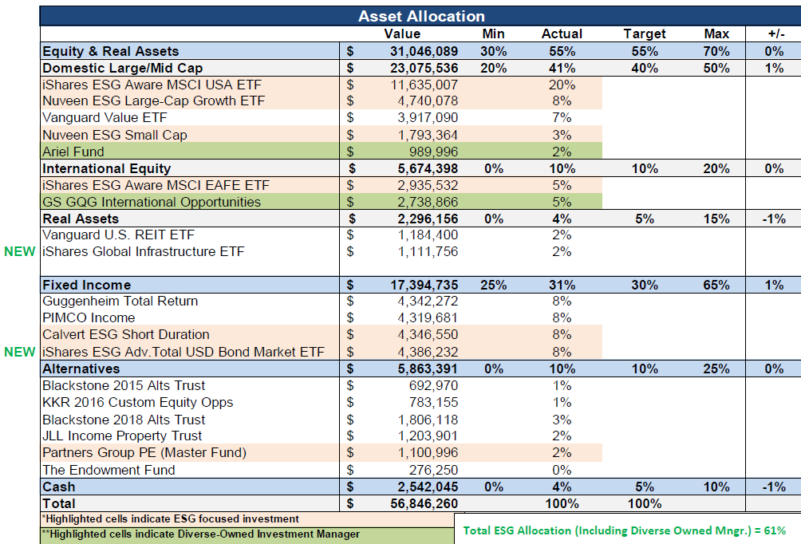
Endowment Asset Allocation as of 5/31/23

Slide 9
Issues Influencing the Financial Markets
The debt ceiling battle in Congress is over i.e., completed before the deadline but does not
significantly alter the fiscal or economic outlook
The buzz surrounding “Artificial Intelligence (AI)” continues to grow
- Industrials expect greater adoption of AI applications requiring greater power density
- Industry leaders like NVIDIA have expanded product pipelines
AI spending will likely occur within the broader capital expenditures spending cycle on automation, reshoring, “Green”, etc.
The new Bull Market case for stocks is productivity
Federal Reserve paused rate increases during their June meeting as economic data, employment stats, inflation, and housing all point to weakness
April job openings rose unexpectedly by 358K to 10.1 million vs an expected decline to 9.4 million
ESG/Sustainable investing continues to receive serious challenges from states around the country i.e., Idaho and Oklahoma, etc.

Slide 10

Endowment Trustee Activities
Held an initial discussion with the ALA Investment Adviser (Merrill Lynch) on the potential impact of the “Artificial Intelligence (AI)” on the portfolio and the market
After reviewing and discussing applicants for the open Endowment Trustee position, forwarded a recommendation to the Executive Board
Reviewed with management the process i.e. timeline for the application of future spending/payouts drawdowns from the endowment
Reaffirmed the need to keep ESG/DEI* investing as a portfolio priority
Received approval from the Executive Board on the recommendation to reappoint Endowment Trustee Rhea Lawson for a second three-year term
Invited directors and leaders from Blackrock and the Partners Group to discuss ESG/Sustainable investments and private equity
*Environmental, Social and Governance aka socially responsible investing/Diversity, Equity and Inclusion
Notes:
The work of the Trustees – recent actions

Slide 11

ALA Endowment Trustees
CONTACT: mgonzalez@passaicpubliclibrary.org
Mario Gonzalez, Senior Trustee – 2023
Peter Hepburn, Treasurer – 2025
Brett Bonfield – 2024
Rhea Lawson – 2026
James G. Neal – 2025
Janice Welburn – 2025
Shali Zhang – 2024
Supported by ALA Finance staff and The Bhatia Group, Merrill Lynch Investment Advisers
Charge
To hold, invest, reinvest and disburse endowment funds; select endowment investment managers; report endowment status to the Executive Board, Council and Membership.

